Slide 1
Software Development Life Cycle
ITDEV117 Team 2

Slide 2
Phases of a Typical Software Development Life Cycle

Slide 3
Requirements and Analysis
This is the planning phase. During this time, the clients and companies determine what they need from their developed software. They they determine what would be cost prohibitive and the desired time frame. Initial relationships are built between clients, executives and developers.

Slide 4
Design
During this phase the design of the software solution is determined. This is where developers sit down with clients and hash out what the clients need and establish how these needs can be met within their previously established limits.

Slide 5
Implementation and Coding
The development team gathers to put forth a plan for execution. A time frame is established with various goals along milestones to the project’s completion. Team members are given tasks usually by a Development Lead and regular updates are given to ensure the project is being developed within the established time frame.

Slide 6
Testing
Once the initial coding is finished quality assurance teams test the ‘qual’ product thoroughly for any code defects, bugs or negative user experiences. If further development is needed, the code is fixed or rewritten and goes back to quality assurance for testing.

Slide 7
Deployment
Once the software is finished with quality assurance and it is deemed finished with the client’s specifications in mind, it is considered ready for production. The software is usually ‘rolled’ into production and the client is notified that their software is now live.

Slide 8
Maintenance
Continued maintenance is required after deployment. As thorough as quality assurance may be, end users will inevitably find bugs or other issues with the software that will need to be addressed. When this occurs, the SDLC starts again with regard to the solution for a fix, culminating in a new production release.

Slide 9
Methodologies

Slide 10
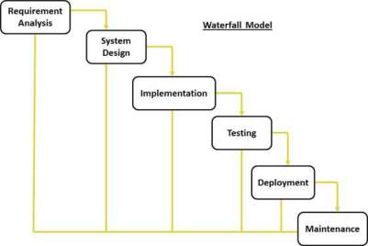
Waterfall
Original Methodology
Sequential order
Clients only consulted once
Potential for running over budget
Very little flexibility for change during development

Slide 11
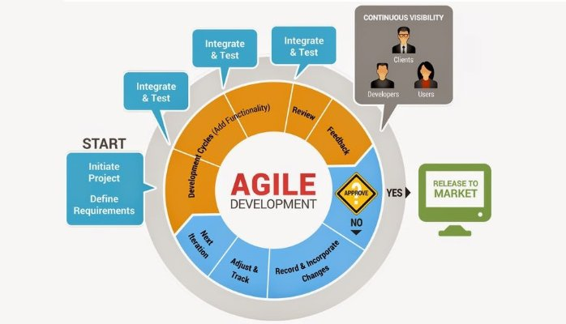
Agile
Most popular methodology today
Cyclical order
Fast-paced development cycles
Very flexible
Allows for quick release with less polish

Slide 12
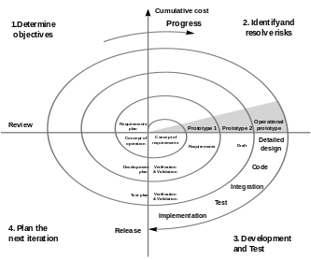
Spiral
Preferred methodology for very complex development with a large organization
Allows for flexibility and polish
Most risk averse methodology
Very slow compared to other methodologies to release

Slide 13
Conclusion
There are many more methodologies than the three listed here, but these are the most common. Ultimately, every software development takes its own approach, often resulting in a unique hybrid that tailors itself to the needs of all the individuals involved. The most important reason for having a SDLC methodology is establishing a mindful approach to development to maximize efficiency and reduce present and future development costs.

Slide 14
Team 2
Matthew Dal Santo
Michael Mellon
Clifton McFarlane
Felicia Jarosinski

Slide 15
Cited Sources
[1]Wikipedia. Software development process, 2017,
https://en.wikipedia.org/wiki/Software_development_process. Accessed 5 Dec. 2017.
[2]IT Knowledge portal. Software Development Methodologies, 2017,
http://www.itinfo.am/eng/software-development-methodologies/. Accessed 5 Dec. 2017.
[3]TutorialsPoint. Software Development Life Cycle, 2017,
https://www.tutorialspoint.com/software_engineering/software_development_life_cycle.htm. Accessed 5 Dec. 2017.

Slide 16
References
BA approach to adopt Agile as a right SDLC methodology! by Ali Saghaeian , 2016, retrieved from https://www.linkedin.com/pulse/ba-approach-adopt-agile-right-sdlc-methodology-ali-saghaeian/. Copyright 2017 by LinkedIn Corporation.
TC1019 Fall 2016, What about the waterfall method? by Mike Sagnelli , 2016, retrieved from https://kenscourses.com/tc1019fall2016/syndicated/what-about-the-waterfall-method/. CC BY-SA 4.0
Spiral model - Wikipedia, 2000, retrieved from https://en.wikipedia.org/wiki/Spiral_model. Special Report CMU/SEI-2000-SR-008, July 2000.

